Slide 1
EEG-Based Real-Time Attention Feedback System Integrated into Interactive Gaming
Presenter: 蔡宇炫
Instructor: Professor Wei Chun-Shu
Date: June 10
Notes:
Good afternoon, everyone. Today I will be presenting my project titled “EEG-Based Real-Time Attention Feedback System Integrated into Interactive Gaming.” In this project, I’ll demonstrate how we convert live EEG signals into game mechanics—allowing players to control a browser-based snake game using their level of focus.

Slide 2
Outline
Introduction
Materials and Methods
Results
Discussion
Conclusion
Introduction
Methods
Results
Conclusion
Notes:
We’ll start with the basics of Brain-Computer Interfaces (BCI) and EEG, then go into the architecture of our system and how we modified the game. After that, we’ll look at the results from both single-player and multiplayer tests, and finally, we’ll wrap up by discussing the challenges we faced and possible directions for future development.

Slide 3

Introduction
Introduction
Methods
Results
Discussion
Conclusion
Introduction to BCI and EEG:
Brain-Computer Interface (BCI) enables direct communication between brain and external devices.
EEG is a non-invasive method for capturing brainwave signals via scalp electrodes.
High temporal resolution makes EEG ideal for real-time feedback.
EEG frequency bands:
Delta (0.5-4 Hz): Deep sleep
Theta (4-7 Hz): Light sleep or relaxation
Alpha (8-12 Hz): Relaxed alertness
Beta (13-30 Hz): Focused cognitive activity
Gamma (>30 Hz): High-level perception and processing
Notes:
A Brain-Computer Interface, or BCI, is a system that lets the brain communicate directly with machines—without any movement.
In this project, we use EEG. EEG places small metal pads on the scalp to pick up brain activity. These electrodes measure tiny voltage changes—just microvolts—every millisecond.
We analyze these signals by frequency. Brainwaves are divided into five main bands:
Delta for deep sleep
Theta for drowsiness or daydreaming
Alpha for calm relaxation
Beta for focus and mental effort
Gamma for fast tasks like visual processing
In our system, we mainly care about Beta, Theta, and Alpha—because they relate closely to attention and mental state during gameplay.

Slide 4
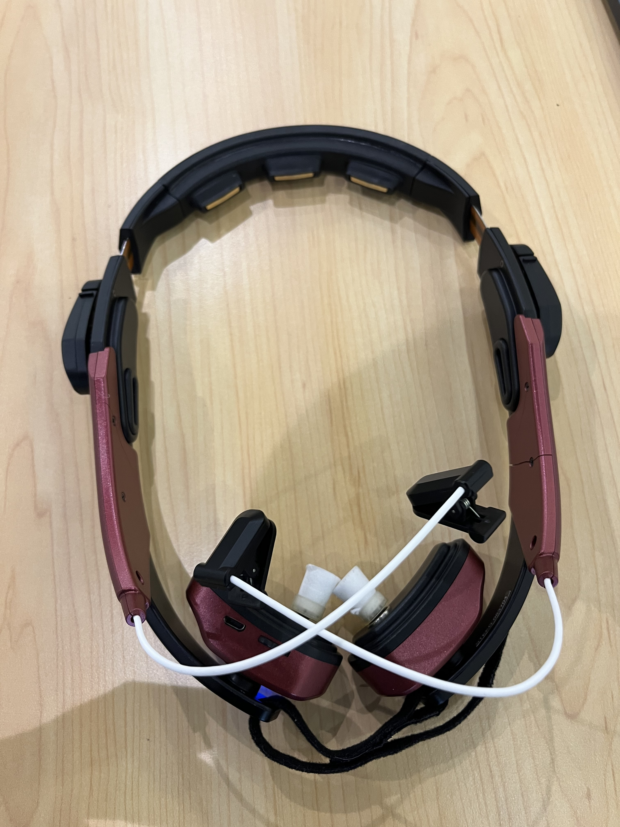
Introduction 6-Channel Cap
Introduction
Methods
Results
Discussion
Conclusion
Equipment:
Used 6-channel dry (wet) EEG cap
Key electrodes: O1 & O2 (occipital)
FFT → power of Beta & Theta
β ↑ = focus θ ↑ = drifting
Ratio β/θ sent to game in real-time
Notes:
Here’s the EEG headset I used. It’s a compact device with six dry electrodes, making it much faster and more comfortable to wear compared to traditional wet systems. For this project, we focused on the occipital channels, O1 and O2, located at the back of the head. These regions are sensitive to visual and attentional processing, which makes them suitable for tracking focus levels. Inside the headset, a small onboard processor performs Fast Fourier Transform, or FFT. This algorithm breaks down the EEG signals into different frequency bands—kind of like decomposing a sound into individual notes. The system updates roughly every 0.1 seconds and gives us the power levels of Beta and Theta waves in real time. This ratio helps us infer whether the player is focused or distracted, and sends that value into the game continuously.
＿＿＿＿＿＿＿ Quick-Answer Cheat Sheet
(English, plain words – keep in your notes)
How do we get the β / θ ratio?
“We stream the 6-channel Cygnus EEG into OpenViBE. OpenViBE band-pass filters Beta (13-30 Hz) and Theta (4-7 Hz), runs a Spectral-Power box – that box uses an FFT to estimate PSD – then divides Beta power by Theta power once every 250 ms. The single ratio value is sent through LSL and WebSocket into the browser.”
What’s the difference between FFT and PSD?
FFT
Fast Fourier Transform – the math algorithm that converts time-domain data to frequency bins.
PSD
Power Spectral Density – the result after squaring FFT magnitudes and (optionally) averaging; gives “power” in each band.
In OpenViBE the Spectral Power box runs an FFT under the hood and outputs PSD values, so we just say “FFT-based PSD”.
Pipeline in 4 bullets
Band-Pass Filters — Theta 4-7 Hz, Beta 13-30 Hz.
FFT → PSD every 256 ms window (Hamming).
Compute β / θ power ratio, smooth with 3-sample moving average.
LSL → Python WS → Browser (≈ 80 ms end-to-end).
If they ask about artefacts or sampling
Artefacts – “Prototype still has eye-blink noise; future work will add ICA cleaning.”
Sampling rate – “Cygnus streams 500 Hz; we update the ratio at 10 Hz to keep latency low.”
Memorise the first quotation line; the rest is backup detail if the committee digs deeper.

Slide 5
Introduction EEG Metrics of Interest
Introduction
Methods
Results
Discussion
Conclusion
Our system focuses on real-time analysis of:
Beta/Theta Ratio (main index for attention level)
Alpha wave (indicative of relaxed state)
Beta/Theta Ratio:
High ratio = focused attention
Low ratio = inattentiveness
Widely used in ADHD research
Alpha wave application:
High alpha power = relaxation
Potential future use: inducing a rest state in gameplay
Notes:
We convert these brain signals into a single live number: the Beta-to-Theta ratio.
When this ratio goes up, the person is concentrating. When it drops, it means their mind is drifting.
This ratio is actually used in ADHD research to measure attention levels in clinical settings. We’ve adapted it here to control game mechanics in real time.
We send this ratio into the browser game—so when a player focuses, the game reacts. For example, the snake might move faster, or stay alive longer when attention is high.
We also track Alpha power. A high Alpha signal suggests the person is relaxed. In future versions, we plan to integrate Alpha waves as a second control layer—maybe letting the snake “rest” or pause when the player is calm enough.

Slide 6
Introduction Research Motivation & Objectives
Introduction
Methods
Results
Discussion
Conclusion
Motivation:
EEG signals are abstract and hard to interpret
Aim: Make EEG feedback intuitive using visual/game-based interaction
Objectives:
Build a game interface that visualizes EEG attention metrics
Analyze how real-time neurofeedback affects gameplay and user awareness
Design an interactive game using modified Slither.io with integrated BCI controls
Notes:
Brain data can be abstract and hard to interpret.
So, we translate those numbers into something visual and interactive—like real-time feedback and changes in game speed.
This project had three main goals:
Create a live, responsive view of attention using EEG.
Observe how real-time feedback affects gameplay behavior.
Keep everything lightweight and accessible— all running inside a simple browser-based snake game.
By connecting brain activity to direct, visible changes, we make mental states not just measurable, but playable.

Slide 7
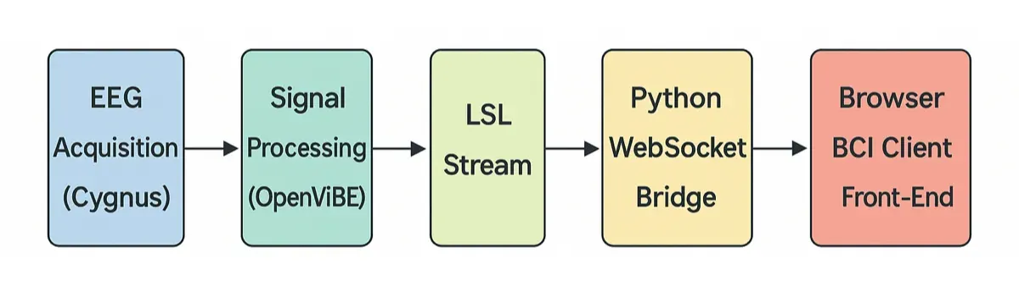
Methods System Architecture
Introduction
Methods
Results
Discussion
Conclusion
To achieve real-time interaction between EEG signals and the game, the system architecture of this project is divided into the following steps:
EEG device (Cygnus) captures real-time brain signals
OpenViBE processes signals and computes Beta/Theta ratio
Lab Streaming Layer (LSL) streams real-time data
Python WebSocket Bridge transfers LSL data to web frontend
Game frontend (JavaScript + Phaser.js) visualizes and reacts to ratio
Notes:
Here’s an overview of our full system architecture—from brain signals to game interaction.
To achieve real-time interaction between EEG signals and the browser game, the entire system is divided into five steps:
First, the EEG device—Cygnus in our case—captures real-time brain signals from the user’s scalp.
These raw signals are sent to OpenViBE, which processes the data and calculates the Beta-to-Theta ratio—our main measure of attention.
The ratio is then streamed using Lab Streaming Layer, or LSL, which allows real-time signal transmission over the local network.
Since LSL doesn’t work directly in browsers, we use a Python WebSocket Bridge to receive the data and forward it in a browser-friendly format.
Finally, our JavaScript + Phaser-based game reads the ratio, visualizes it on screen, and uses it to control snake speed and behavior.
You can see the full pipeline here in the diagram—from EEG acquisition all the way to the browser frontend.

Slide 8
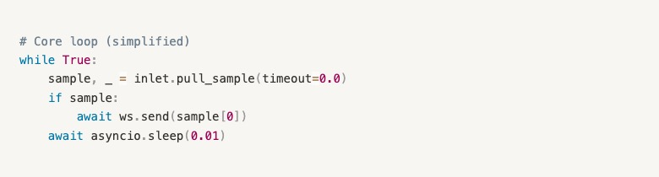
Methods LSL to WebSocket Bridge
Introduction
Methods
Results
Discussion
Conclusion
Why a WebSocket Bridge?
Lab Streaming Layer (LSL) streams EEG data over a local network, but it doesn’t speak HTTP or work inside browsers.
Browsers can’t access LSL directly because of sandbox restrictions and lack of native LSL support.
Solution: Python WebSocket Bridge
We built a Python script that:
Subscribes to LSL stream (reads Beta/Theta ratio in real time)
Serves a WebSocket endpoint
Pushes data to browser clients every 100 ms
Notes:
Now let’s look at how we actually send EEG data from the backend into the browser.
We use Lab Streaming Layer, or LSL, to stream EEG signals locally in real time.
However, browsers can’t access LSL directly, because it doesn’t use HTTP and it’s blocked by sandbox restrictions. So we need a bridge.
Our solution is to build a Python WebSocket Bridge.
This script does three things:
It subscribes to the LSL stream, which gives us the Beta/Theta ratio in real time.
It opens a WebSocket endpoint for the browser to connect.
And it pushes the latest EEG value to all connected clients every 100 milliseconds.
Here on the right, you can see a simplified version of the main loop.
It checks for a new EEG sample, and if available, it sends it straight to the browser.
We use asyncio to keep the loop non-blocking and lightweight.
This is what makes it possible to drive a browser game using live brain data.

Slide 9
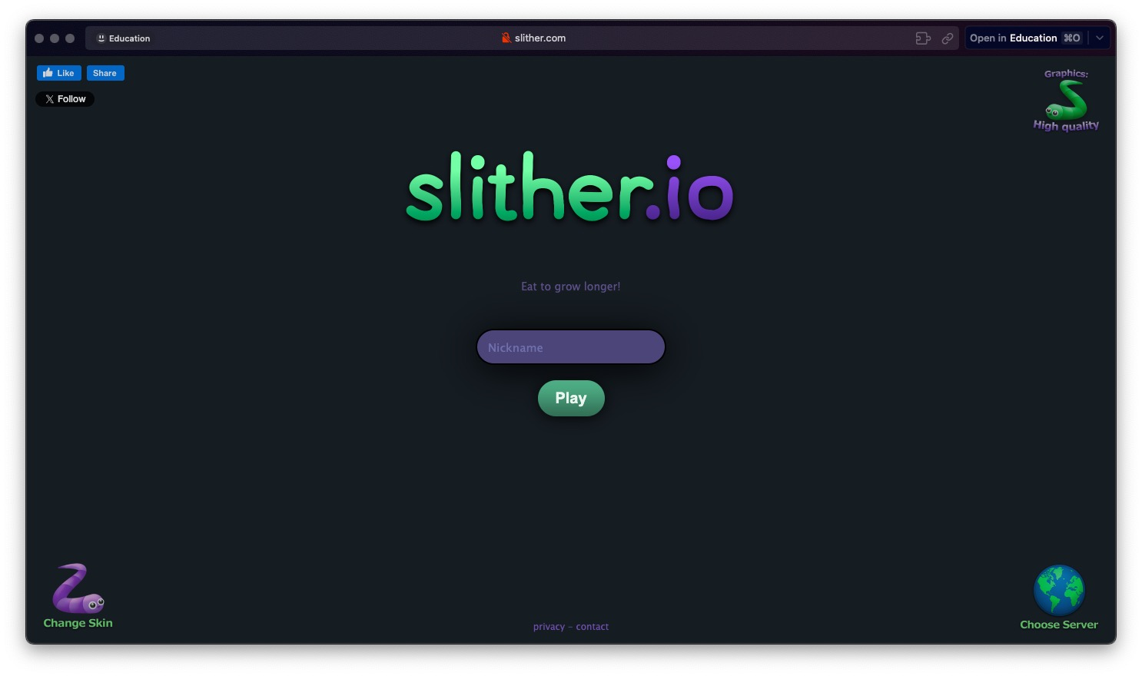
Methods Game Implementation: EEG-Responsive Snake Game
Introduction
Methods
Results
Discussion
Conclusion
Framework & Base Code
Phaser 3 (vanilla JS)
Based on open-source Slither clone
Custom Modifications
AI bots for continuous gameplay
World-wrap physics for infinite-feeling space
Real-time EEG overlay
→ Includes Beta/Theta bar
→ Live focus marker updates every 0.1 seconds
Real-time EEG overlay
Beta/Theta bar + focus marker
Notes:
Let me first explain how we built the game itself and what changes we made.
We started with an open-source clone of Slither.io, and rebuilt it using Phaser 3, a lightweight JavaScript game framework. It’s written in vanilla JS, so we didn’t need Unity or WebGL. That makes it easier to integrate EEG input directly into the game.
Then we applied several custom modifications.
We added AI-controlled bots, so even in single-player mode, the map stays active and engaging.
We also implemented world-wrap physics—meaning the snake can move off one edge and reappear on the other. This makes the map feel continuous, like a looped space.
Finally, we built a real-time EEG overlay, which displays the Beta/Theta ratio live during gameplay. The system updates every 0.1 seconds, showing a moving focus marker and a visual bar. This makes brain activity easy to see, moment to moment.

Slide 10
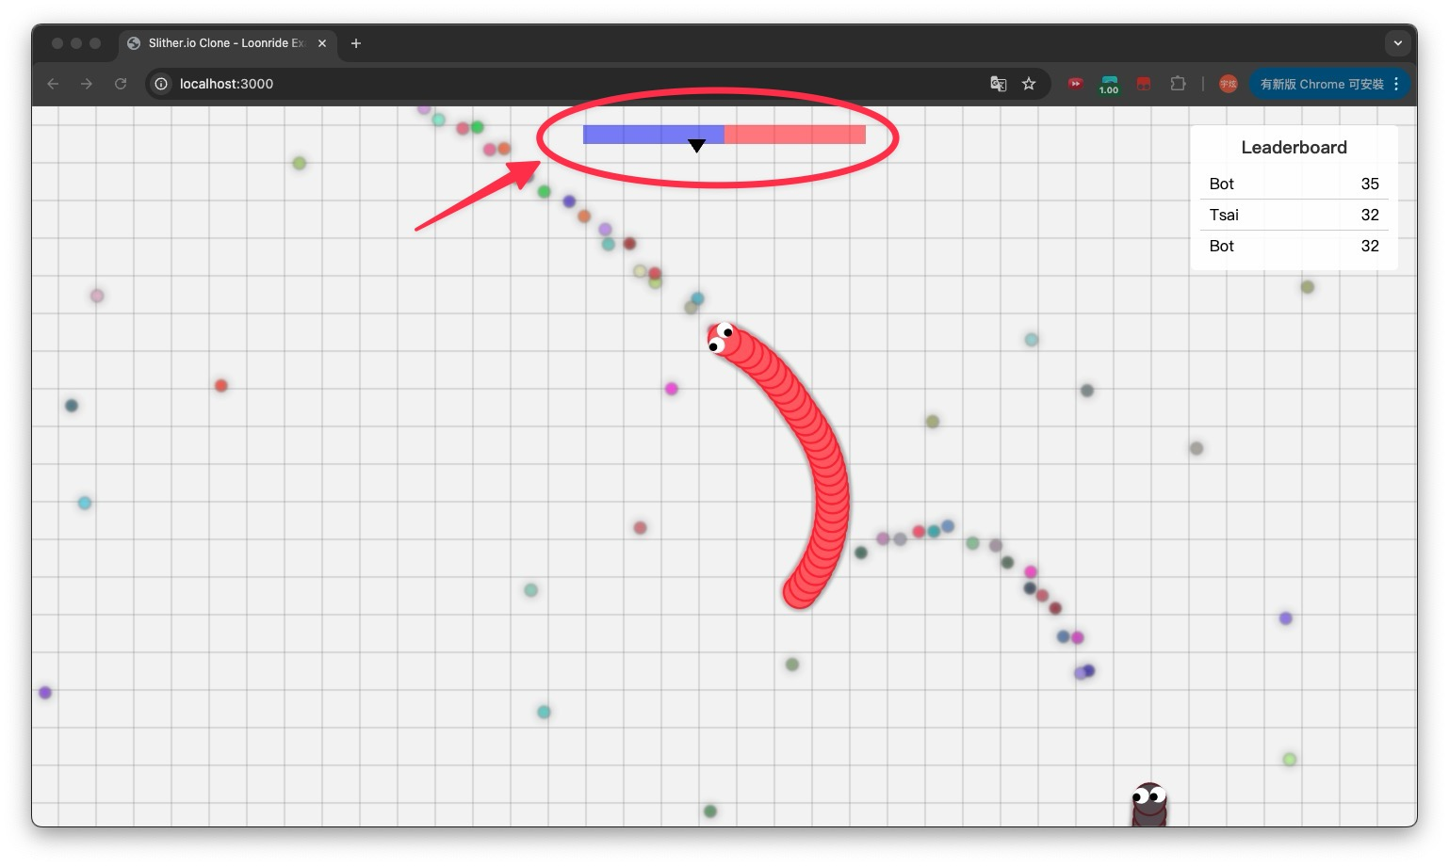
Methods Game Integration
Introduction
Methods
Results
Discussion
Conclusion
Based on Slither.io
Game logic:
Higher Beta/Theta ratio: snake moves faster
Lower ratio: snake slows down
Added real-time visual feedback:
Red/blue ratio bar
Upward triangle indicator reflects attention ratio
Notes:
This slide explains how EEG data is connected to gameplay.
We used the logic from Slither.io as a foundation, but added brain-controlled speed.
The key idea is this:
When your Beta-to-Theta ratio is high, that means you’re focused—so the snake moves faster.
When the ratio is low, you’re less focused, and the snake slows down.
This creates a live, brain-driven control loop. You’re not pressing buttons—the game reacts to your mental state in real time.
To make this visible, we added a red-and-blue ratio bar at the top of the screen.
An upward triangle acts as a marker that reflects your current attention level.
You can see that in the screenshot here: the bar updates every 0.1 seconds, so players can actually “feel” when they’re focused or drifting.

Slide 11
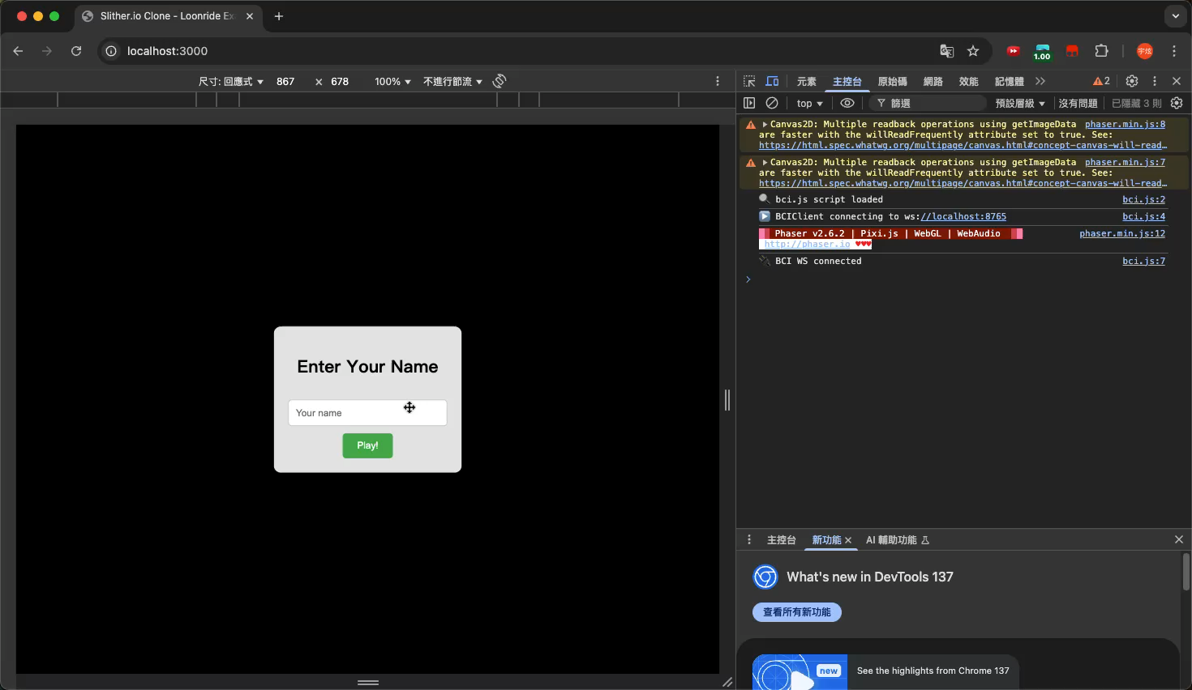
Results (Single User)
Introduction
Methods
Results
Discussion
Conclusion
Successfully integrated EEG signal with real-time browser game
Ratio values transmitted and reflected instantly
Gameplay changes (snake speed) match cognitive state
Helped users become more aware of their focus level
https://youtu.be/Ay3iZjaHcZ8
Notes:
This is a short demo clip of our working system.
On the left, you can see the game screen—it looks like a standard Slither.io game. But there’s one big difference: this snake is being partially controlled by brainwave activity.
At the top of the screen, we added a red-blue horizontal bar. This bar visualizes the user’s Beta-to-Theta ratio in real time. When the black triangle moves to the right, it means higher focus. When it shifts left, it indicates more mental drifting.
On the right side, in the developer console, we show the actual EEG ratio values being received about every 0.1 seconds.
This gives the player a powerful incentive to stay sharp. In high-pressure moments—like when other snakes get close—the player’s brain naturally gets more engaged. You can see the ratio rise in real time, and the snake reacts instantly.
Some users even reported that they tried to intentionally concentrate harder—just to go faster and outmaneuver the bots. This creates a unique feedback loop: the more focused you are, the faster you go—and the better chance you have to win.

Slide 12
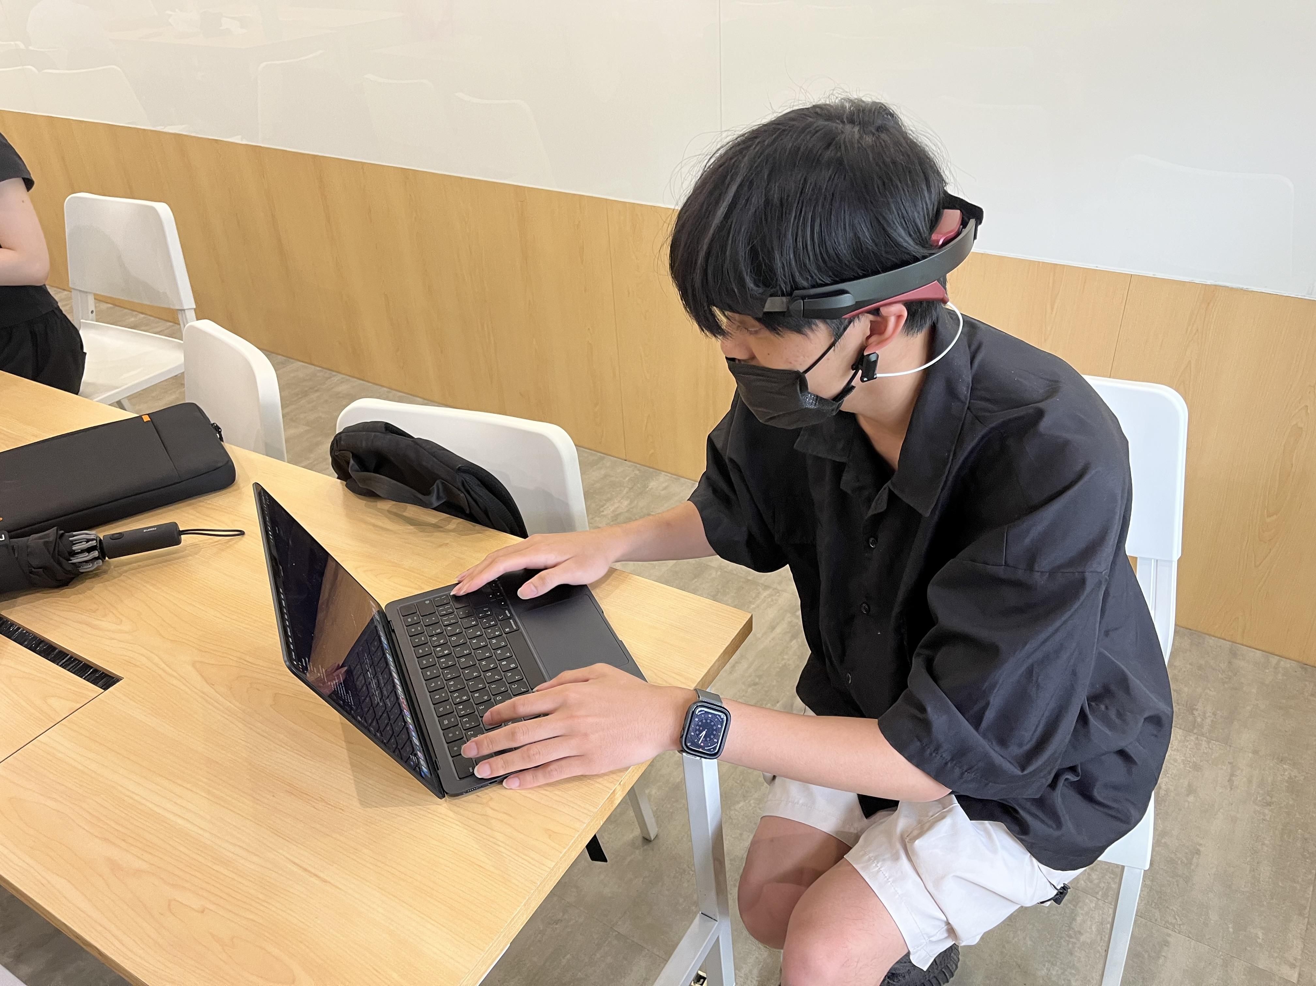
Results Multi-User Prototype
Introduction
Methods
Results
Discussion
Conclusion
Developed multiplayer mode where each player uses their own EEG input
Each player controls a snake with individual attention metrics
Demonstrates potential for competitive neurogaming
Prototype only; no advanced sync or battle logic implemented yet
Notes:
We also developed a multi-user prototype to explore how this system could scale beyond a single player.
In this mode, each player wears their own EEG device and connects independently to the game.
Each snake is then controlled using individual Beta/Theta ratios, so each player’s focus directly affects their own gameplay.
This setup shows real potential for what we call “competitive neurogaming”—where players aren’t just controlling the game with reflexes, but also with their mental focus.
Right now this is still a prototype. Ｉ haven’t added full synchronization or real-time battle logic yet, so players don’t compete directly.
But the core infrastructure—multiple EEG streams controlling separate game entities—already works.

Slide 13
Discussion Discussion & Challenges
Introduction
Methods
Results
Discussion
Conclusion
Technical Challenges:
EEG signal stability and noise filtering
Real-time processing demands
Design Considerations:
Only speed controlled by attention; other EEG features (like Alpha) not fully utilized
Future opportunities:
More EEG metrics
Deeper gameplay integration
Enhanced user engagement
Notes:
Now let’s reflect on the key challenges and lessons from this project.
On the technical side, we faced common EEG issues:
Signal stability and noise, especially in real-world environments
And the demand for real-time processing, which leaves little room for latency or data loss
From a design perspective, we focused only on one EEG metric: attention, mapped to speed.
Other useful signals—like Alpha for relaxation—weren’t used yet, so the interaction is still quite limited.
Looking ahead, we see clear opportunities:
Bringing in more EEG metrics beyond attention
Tighter integration with gameplay—beyond just speed
And using this to create deeper, more immersive engagement, not just control
These are directions we believe can turn this from a prototype into a meaningful neurogaming experience.

Slide 14
Conclusion Conclusion & Future Work
Introduction
Methods
Results
Discussion
Conclusion
Conclusion:
Demonstrated feasibility of integrating EEG metrics into game control
Created engaging system for attention visualization
Future Work:
Conduct more experiments with full EEG setup
Add Alpha wave for relaxation control (e.g., snake resting)
Enrich game design with items and map events
Explore motor imagery control for hands-free snake movement
Notes:
To wrap up:
This project shows that it’s entirely possible to integrate real-time EEG data into a browser game.
We built a working system where brain activity controls gameplay, and players can visualize their focus as they play.
As for what’s next:
We want to run more tests with full EEG setups and more users
We’ll add Alpha wave control, so relaxed states could pause or rest the snake
We also plan to enrich the game—maybe with items, new map zones, or event triggers
And finally, we hope to explore motor imagery control in the future—for full hands-free movement using imagined motion
That’s the future we’re aiming for:
Games that don’t just respond to clicks, but to cognitive and emotional states.

Slide 15
Thank You

